Slide 1
Analysis of LTI/LSI Systems
Ajit S. Bopardikar
Conexant Systems Pvt. Ltd.
Hyderabad

Slide 2
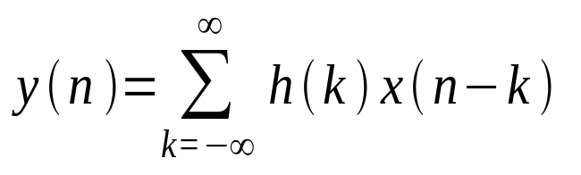
Difference Equations: Introduction
General relationship between input and output in a LSI/LTI system
Suggests a method to implement such systems-especially for FIR systems
How can you implement an IIR system using finite memory, addition and multiplication operations?

Slide 3
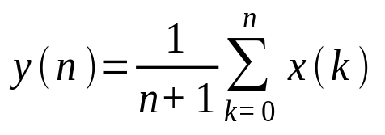
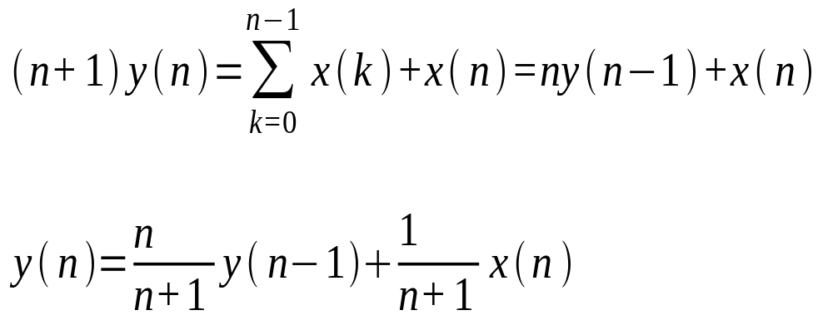
Difference Equations: Example-Cumulative Average
Increasing number of additions and memory if implemented directly.
A recursive relationship can change that

Slide 4
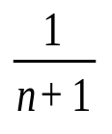




Cumulative Average: System
Unit
Delay
Current output depends on the previous output and the present input

Slide 5
Recursive System
A system that depends on any number of past output values
Should have finite number of delays or equivalently have a finite number of storage locations
For a causal, practically realizable recursive system

Slide 6
Nonrecursive Systems
Current output depends only on present and past inputs
Example: In convolution, output is a linear weighted sum of the present and past inputs

Slide 7
Recursive and Nonrecursive Systems: Comparison
Feedback loop in the recursive system feeds back previous outputs into the input
To compute present output in recursive systems, one needs a finite number of previous outputs. Outputs need to be computed in order
In a nonrecursive system previous outputs are not needed to compute the present output. Therefore any random output value can be computed

Slide 8

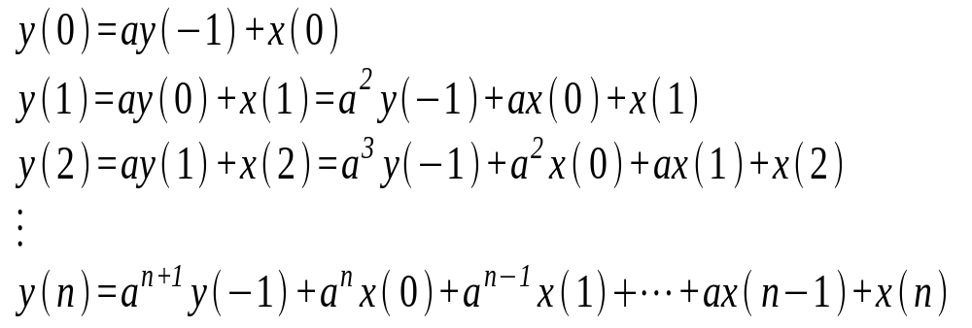
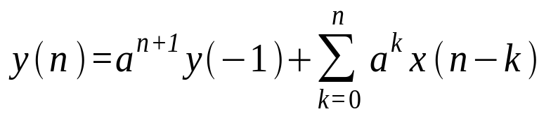
Constant Coefficient Difference Equations: Example
LTI/LSI System

Slide 9
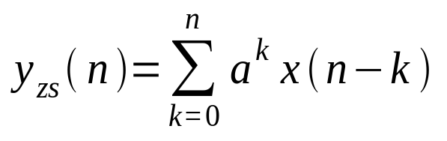
Constant Coefficient Difference Equation: Example
Output is a result of the initial condition and input
If system relaxed at n=0, then memory should be zero and y(-1)=0 (zero state)‏
Initial conditions zero and output called zero-state response or forced response

Slide 10
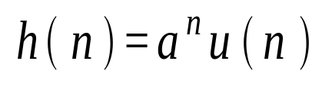
Constant Coefficient Difference Equation: Example
and
Above system is causal
The relaxed recursive system described by the difference equation is LTI/LSI IIR system with above impulse response

Slide 11

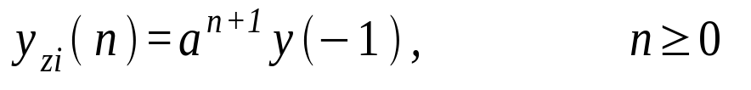
Constant Coefficient Difference Equation: Example
If system initially non-relaxed
If x(n)=0 for all n, then the output is called a zero-input response or natural response
In this case

Slide 12
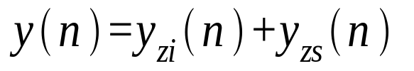
Constant Coefficient Difference Equations: Example
Zero-input response is due to the memory of the system
It depends only on the nature of the system and the initial conditions
Total response of the system can be represented as

Slide 13
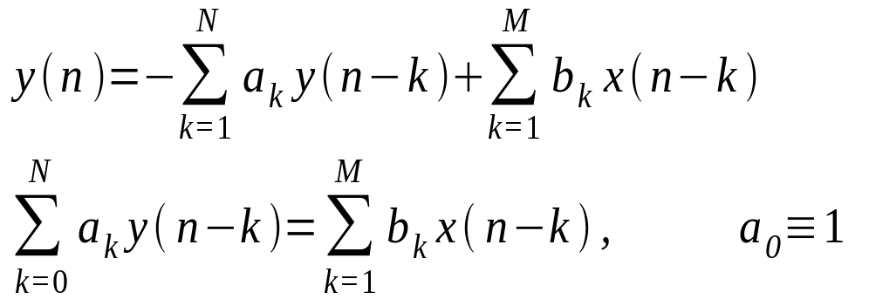

Constant Coefficient Difference Equations
Above is a N^{th} order difference equation
To compute output for any non-negative n, we need the inputs as well as the initial conditions

Slide 14
Constant Coefficient Difference Equations: Linearity Conditions
Total response is the sum of the zero-input and zero-state responses
Principle of superposition applies to zero state response
Principle of superposition applies to zero input response

Slide 15
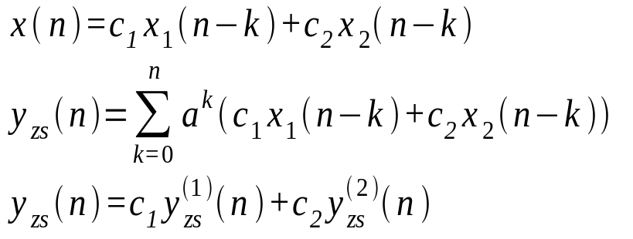
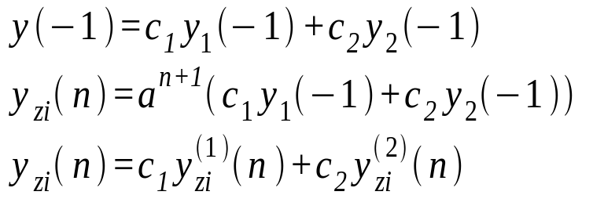
Linearity Conditions: Example
Zero-state response
Zero-input response

Slide 16
Time invariance
Constant coefficients ensures invariance
Thus, a system defined by a constant coefficient difference equation is LTI/LSI

Slide 17
Stability
For every bounded input and every bounded set of initial conditions, the total system response is bounded

Slide 18
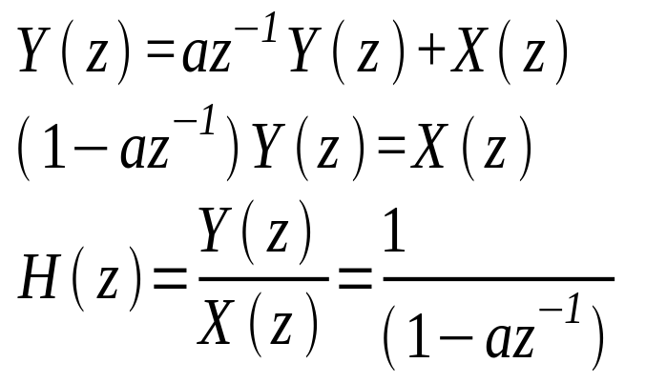
z-Transform of Difference Equations: Example
Transfer function describes the relationship between input and output of a system

Slide 19
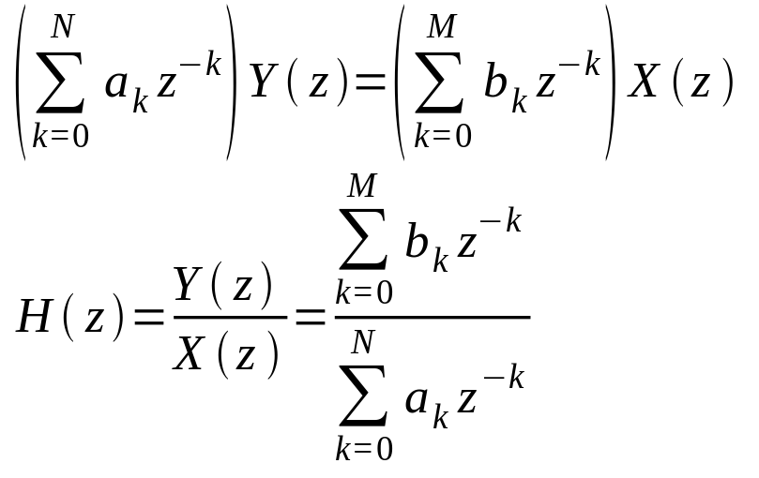
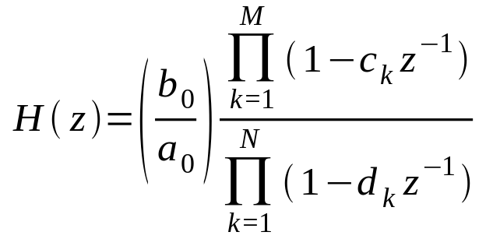
z-Transform of Difference Equations: General Form
zeros
poles

Slide 20
Region of Convergence
Assuming causality, the RoC will be outside the outermost pole

Slide 21
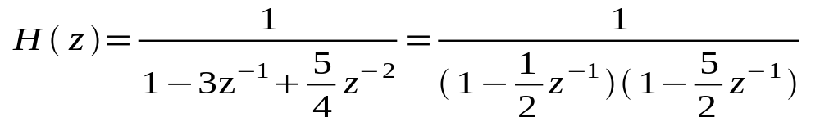
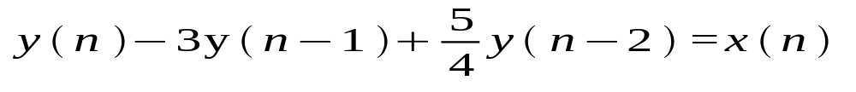
Region of Convergence: Example
Poles at z=1/2 and z=5/2
Corresponding causal system

Slide 22
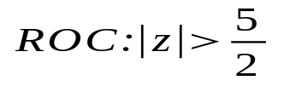
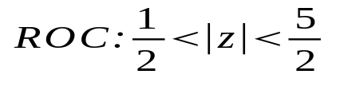
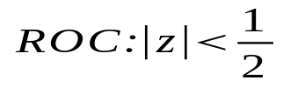
Region of Convergence: Example
Case 1: System is causal
ROC does not include unit circle. DTFT will not converge. System unstable
Case 2: For Stability
Case 3:
System neither stable nor causal

Slide 23
Region of Convergence: Conditions for Causal Stable Systems
For a system that can be represented in the form of a difference equation to be causal and stable, the poles of the system must be inside the unit circle

Slide 24
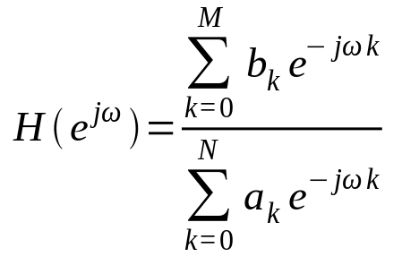
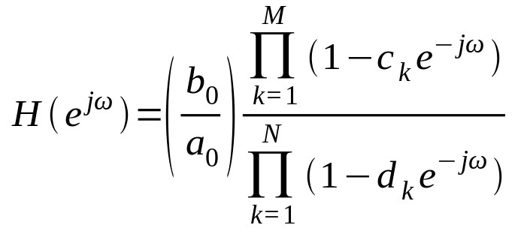
Frequency Response of a Rational System

Slide 25
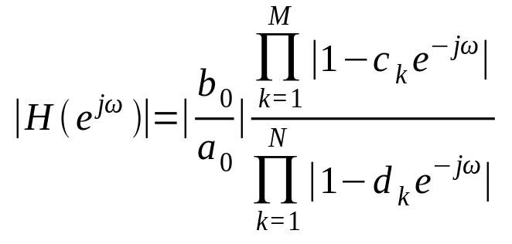
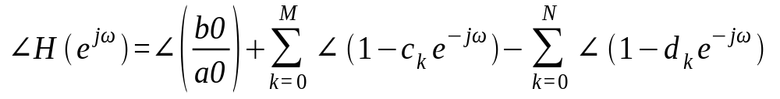
Magnitude and Phase Response of a Rational System
Magnitude Response
Phase Response

Slide 26
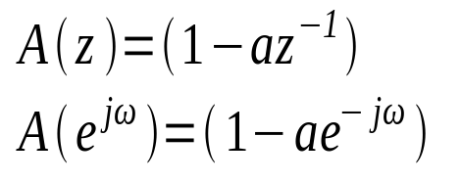
Frequency Response of a Single Zero or Pole
The above expression can be written as

Slide 27

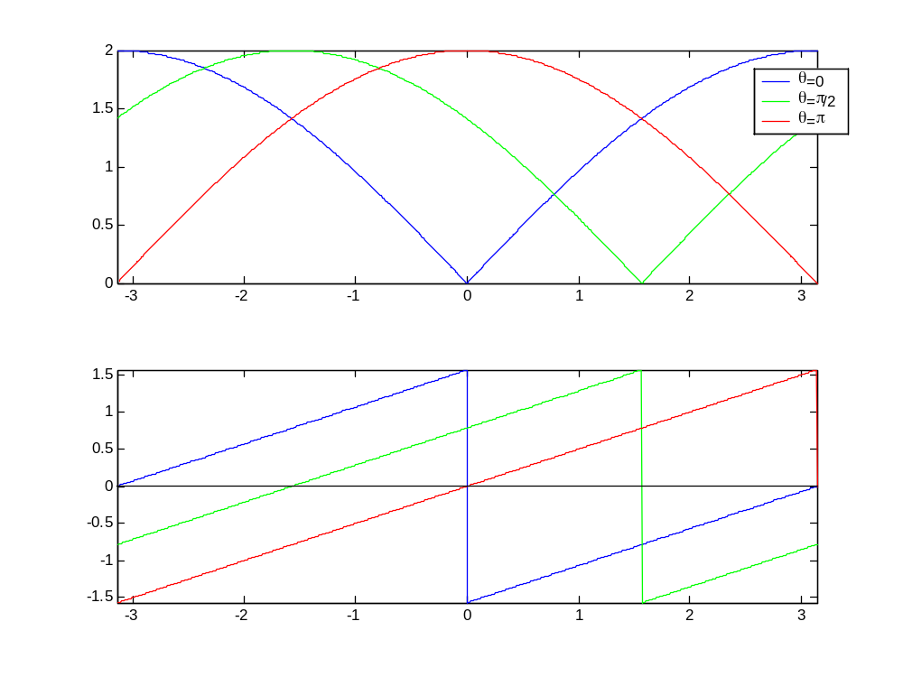
Frequency Response of a Zero
magnitude
-phase

Slide 28
Frequency Response of a Zero
For a constant r, the function shifts with θ.
The function dips sharply in the vicinity of the zero
Phase is zero at ω= θ

Slide 29

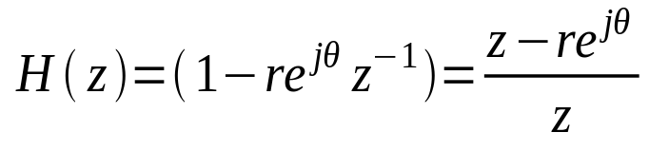


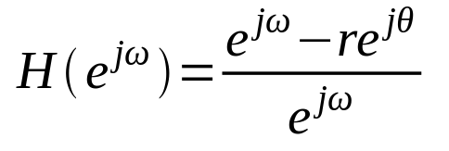




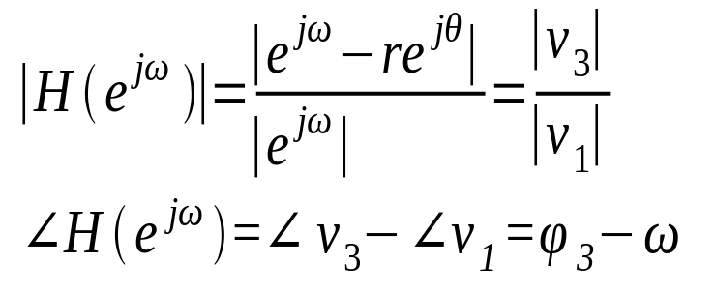


Geometric Interpretation

Slide 30
Geometric Interpretation: Magnitude Response
Zero Vector: Vector from a zero to the unit circle. Likewise, we define Pole Vector
Contribution of a single zero factor to the magnitude response at at a given frequency is the size of the vector from that zero to the frequency on the unit circle
The vector from the pole at z=0 always has unit length. It has no effect on the magnitude response

Slide 31
Geometric Interpretation: Phase Response
Phase response is the difference in angle between the angle of the vector v₃ and angle of the pole vector

Slide 32

Geometric Interpretation: Magnitude and Phase Response
v₃ will reach a minimum when
Phase will also be zero at

Slide 33
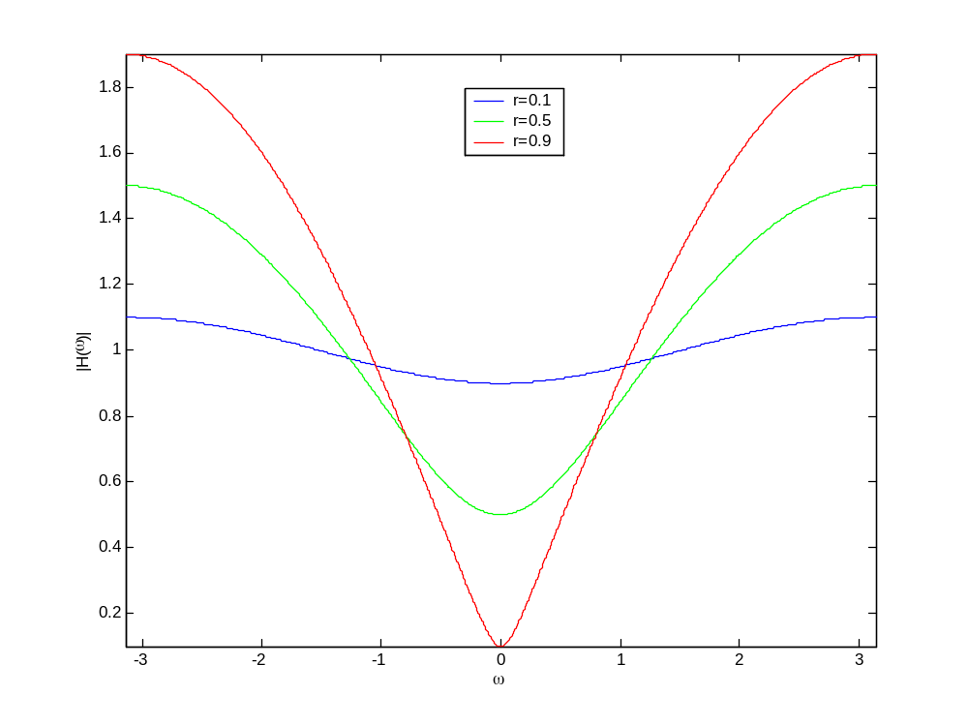
Variation of Magnitude Response with Radius

Slide 34
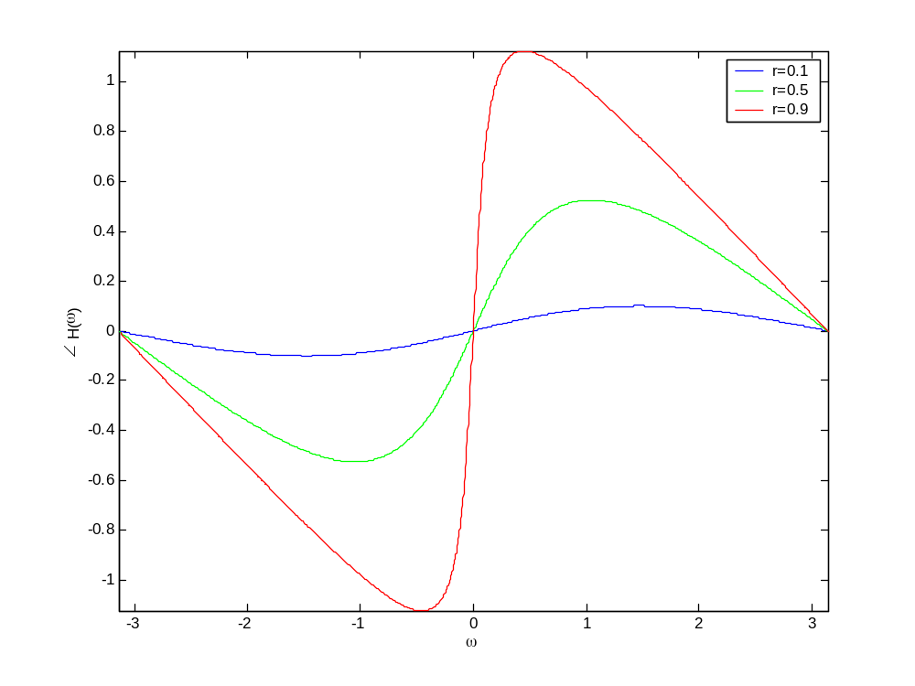
Variation of Phase Response with Radius

Slide 35
Dependence on Radius
Magnitude response dips more sharply as radius of the zero approaches 1
Slope of the phase response increases as the radius approaches 1
At r=1 slope is discontinuous with a jump of π radians
Slope of phase response negative away from

Slide 36
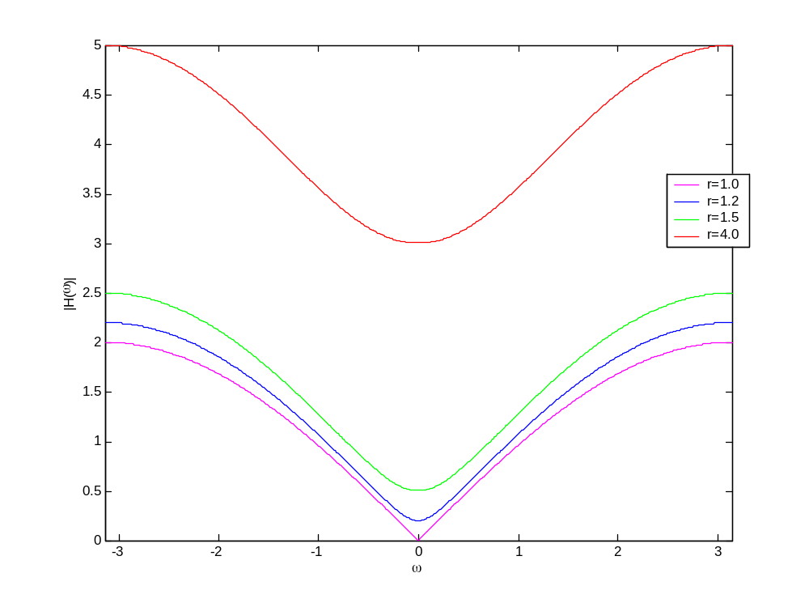
Variation of Magnitude Response for r>1

Slide 37
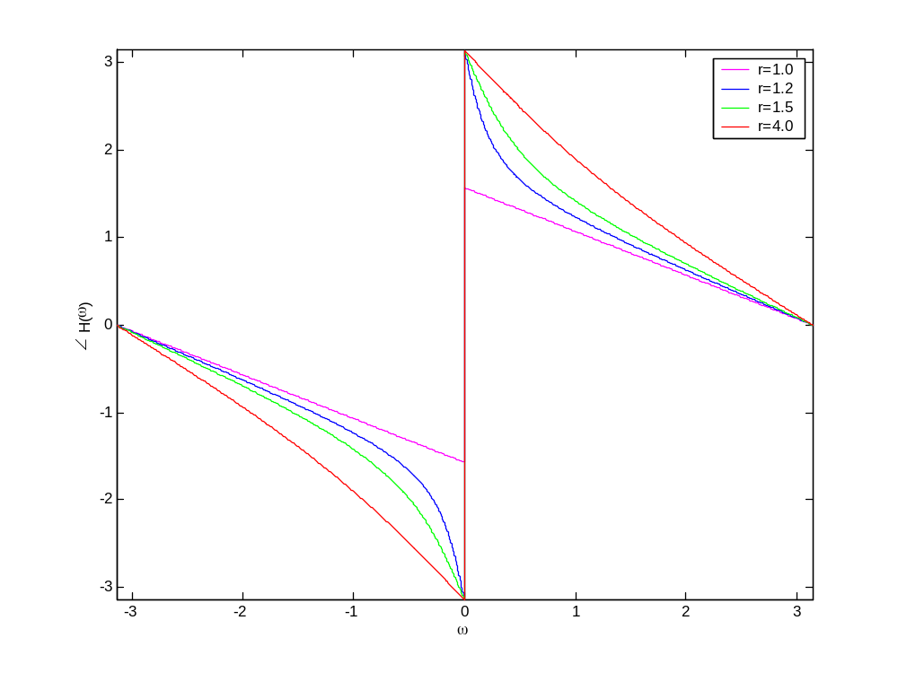
Variation of Phase Response for r>1

Slide 38
Dependence on Radius (r>1)‏
Magnitude response behaves similar to the case r<1: It dips more sharply at
as r gets closer to 1
Phase shows a jump of 2π radians

Slide 39
For a Single Pole
The magnitude response peaks at
r is always less than 1 for stable causal systems
Phase will be negative of the phase for the corresponding zero

Slide 40
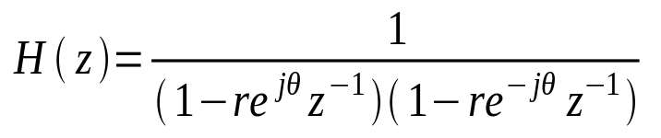
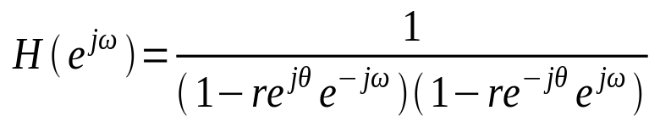
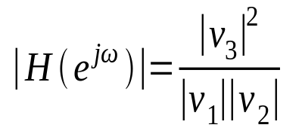

Multiple Poles and Zeros

Slide 41
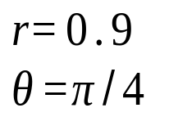
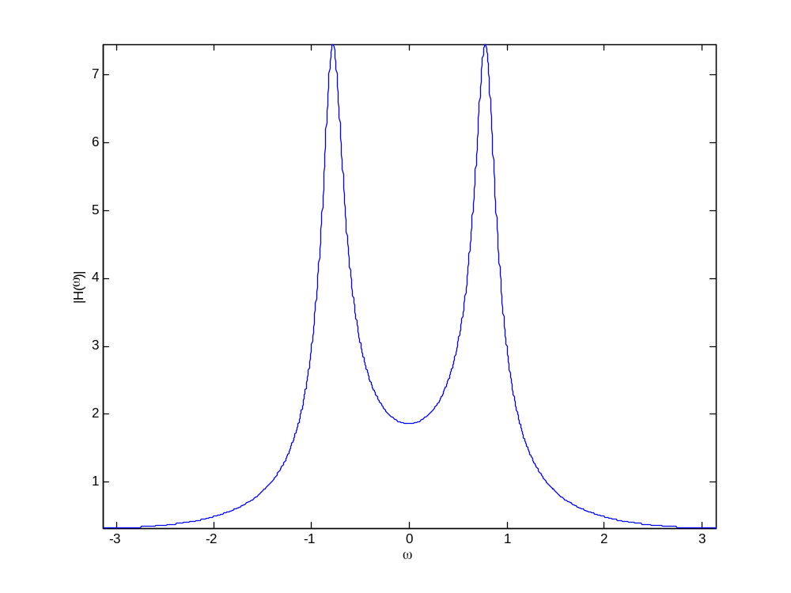
Magnitude Plot

Slide 42
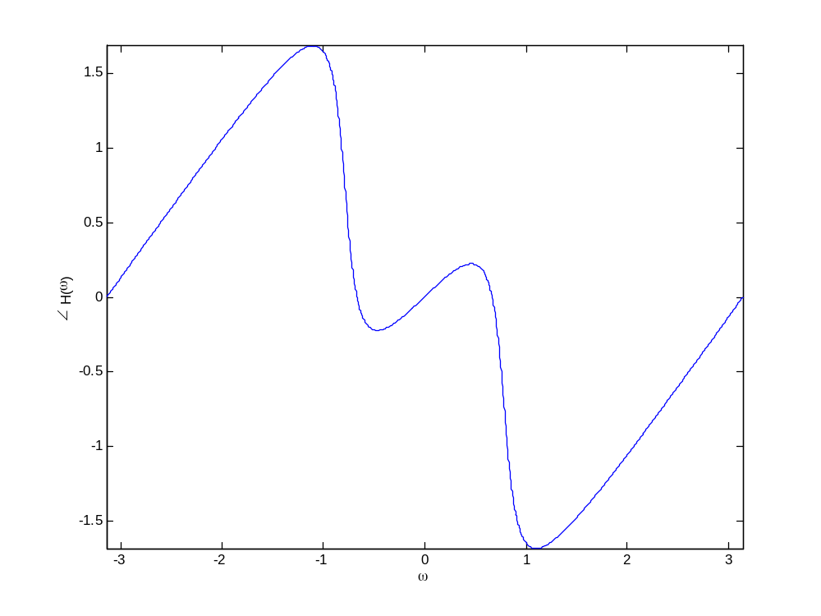
Phase Plot

Slide 43
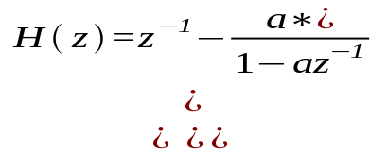
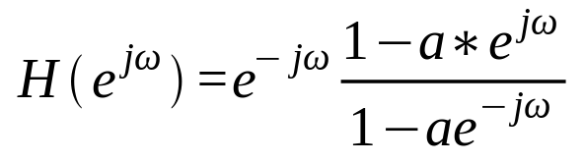
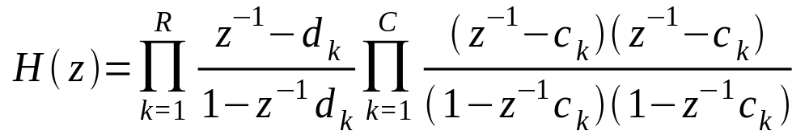
Allpass Systems
Basic System
General System (with real valued impulse response)‏

Slide 44
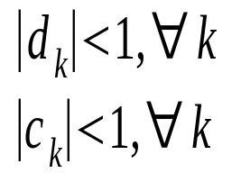
Allpass Systems
For stability
An allpass system passes all frequencies with a magnitude gain of unity
Each pole in an all pass system is paired with a conjugate reciprocal zero

Slide 45
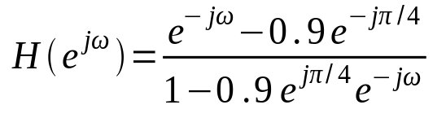
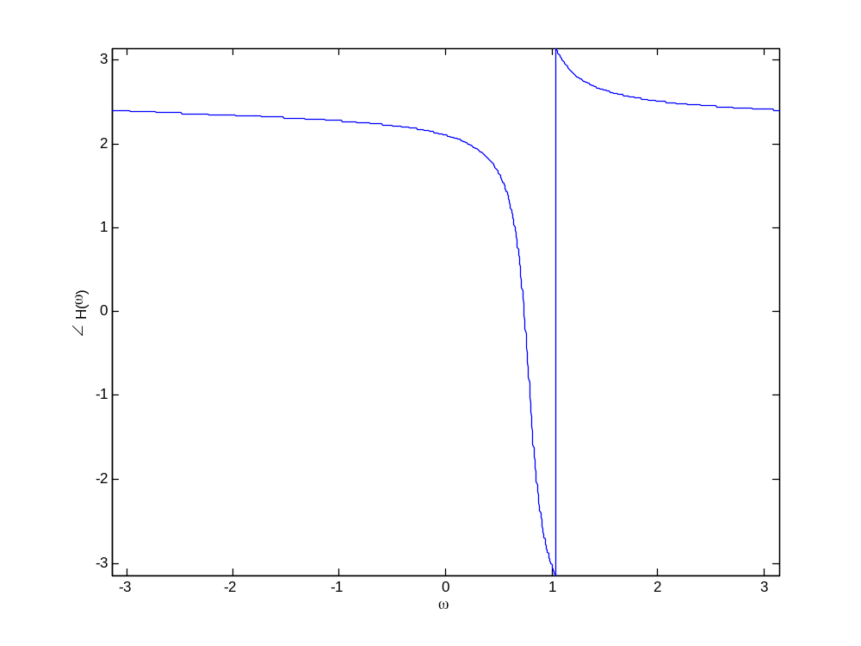
Allpass System: Example

Slide 46
Allpass Systems: Uses
Compensators for phase distortion
Transforming one frequency selective system to another
Minimum phase systems

Slide 47
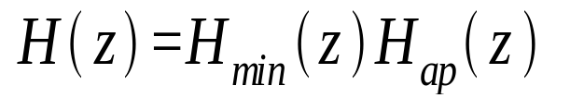
Minimum Phase Systems
Both poles and zeros lie within the unit circle
Any rational function can be represented as a product of a minimum phase filter and an allpass filter

Slide 48
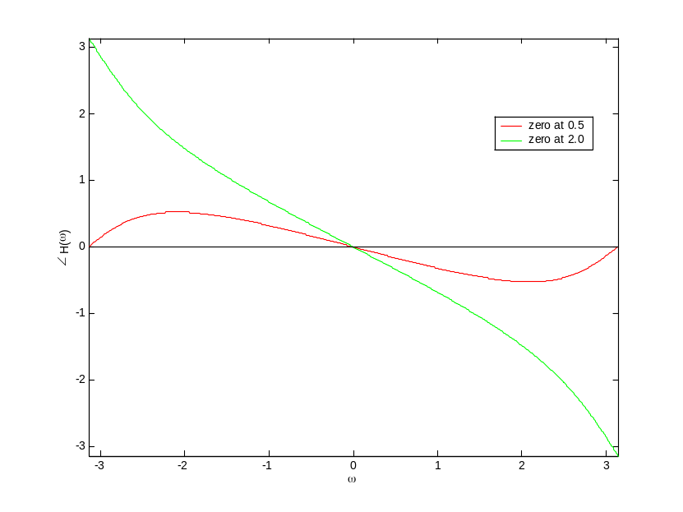
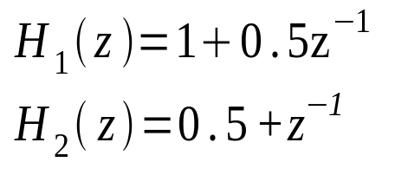


Minimum Phase Systems: Why call them that?
For system H₁(z), phase begins at 0 at ω=0 and is 0 at . Net phase change is 0
For system H₂(z),net phase change is

Slide 49

Minimum Phase Systems
For a generic minimum phase system, net phase change for each zero is 0. Therefore the overall net phase change is also zero
For a mixed phase/non minimum phase system the overall net phase change
M is the number of zeros outside the unit circle

Slide 50
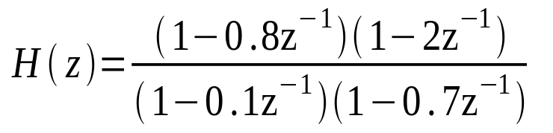

Minimum Phase System: Example
Non minimum phase
Allpass
Minimum phase

Slide 51

Example: Magnitude Response

Slide 52
Minimum Phase Systems
Response of H(z) and H_{min}(z) will be the same
We can form nonminimum phase systems from minimum phase systems by reflecting zeros lying in the unit circle to their conjugate locations outside the unit circle
Likewise, we can form minimum phase systems from nonminimum phase systems by reflecting zeros lying outside the unit circle to their conjugate locations inside the unit circle

Slide 53

Minimum Phase System: Example
Magnitude response will not change if we replace a zero
by its reciprocal conjugate zero

Slide 54
Example: Magnitude Response

Slide 55


Group Delay
Continuous Phase: Phase response as defined as a continuous function of ω.
Denoted by
Group Delay is defined as

Slide 56




Example

Slide 57

Manifestation of Linear and Non-Linear Phase: Input

Slide 58

Manifestation of Linear and Non-Linear Phase: Filter Magnitude Response

Slide 59

Manifestation of Linear and Non-Linear Phase: Linear Phase

Slide 60

Manifestation of Linear and Non-Linear Phase: Non-Linear Phase

Slide 61

Manifestation of Linear and Non-Linear Phase: Response to Linear Phase

Slide 62

Manifestation of Linear and Non-Linear Phase: Response to Non-Linear Phase

Slide 63

Linear Phase FIR Systems: Type 1
Odd number of taps.
M even
0

Slide 64

Linear Phase FIR Systems: Type II
0
M odd

Slide 65

Linear Phase FIR Systems: Type III
0

Slide 66

Linear Phase FIR Systems: Type IV
0

Slide 67


Locations of Zeros for Linear Phase FIR Systems (Type I and II)‏
Using Symmetry
If z₀ is a zero of H(z) then so is 1/ z₀

Slide 68


Locations of Zeros for Linear Phase FIR Systems
For real coefficients
For poles on the unit circle

Slide 69


Locations of Zeros for Linear Phase FIR Systems
If zeros real, then the system will be of the form
If zeros real, and on the unit circle, the zero can appear by itself

Slide 70



Locations of Zeros for Linear Phase FIR Systems
If zeros at
If M is odd
If M is odd the system function must have a zero at

Slide 71



Locations of Zeros for Linear Phase FIR Systems (Type III and IV)‏
For type III and type IV systems
Zero locations similar to type I and type II case, plus
H(z) must have a zero at z=1 for both types

Slide 72



Locations of Zeros for Linear Phase FIR Systems (Type III and IV)‏
When M is even
z=-1 must be a zero when M is even
In general every FIR filter can be factored as follows

Slide 73
Reading List
Oppenheim, A. V., Schafer, R. W., “Discrete-time Signal Processing,” Prentice-Hall, India, 1989.
Proakis, J. G, Manolakis, D. G., “Digital Signal Processing,” Prentice-Hall, NJ, USA, 1996.

